Slide 1
Convolutional Code

Slide 2
Convolutional Code
Another type of very widely used code.
Will explain by a simple example code.

Slide 3
Encoding
Data bits flow in this direction
Encoding is extremely simple.
Remember the last two bits (b1, b0), with b0 being the older one.
Both initially 0
Given new bit b2, calculates
x0 = b2+b1+b0
x1 = b2+b0
x2 = b2+b1
The addition is just exclusive or.
So, for each input bit, outputs 3 bits.
new bit
b1
b0
b2
x0
x1
x2

Slide 4
Decoding
Called the Viterbi algorithm.
Can be explained as a case study in your algorithm class.

Slide 5
Decoding – Problem formalization
If we have a k-bit data string D, the encoder output will be a 3k-bit string denoted as E(D).
We will transmit E(D)in the air, but the channel may corrupt some of the bits. Denote the 3k-bit string we receive as R.
The problem can be formalized as: Finding a k-bit string S* such that the number of difference between E(S*) and R is no larger than that between E(S) and R for any k-bit string S.
Basically, S* will result in minimum cost among all possible k-bit strings

Slide 6
Decoding – Problem formalization
Why is this formalization makes sense?
Assuming the noise is not too bad and flips the bits with small probability independently, this is the maximum likelihood estimation of the data bits.

Slide 7
Decoding
So how do we start?
Suppose the first 3 bits we received are 101. Do you think the first data bit is 0 or 1?
I would say 1 because if it is 0, the encoded bits will be 000; otherwise 111.

Slide 8
Decoding
Suppose the first 6 bits we received are 101011 (from oldest to most recent). Do you think the first two data bits are?
I would say 11 (from oldest to most recent) because
If 00, the encoded bits will be 000000. (distance 4)
If 01, the encoded bits will be 000111. (distance 3)
If 10, the encoded bits will be 111101. (distance 3)
If 11, the encoded bits will be 111010. (distance 2)

Slide 9
Decoding
After receiving 3k bits, the number of possible combinations is 2^{k}. We cannot afford to check and compare all cases.
Therefore, we need a good algorithm. The Viterbi algorithm.
For any input string S of length m (m <= k), the cost of S, denoted as c(S), is defined as the distance from the first received 3m bits and E(S), i.e., the encode bits generated by S.
S*, the optimal string, has the minimum cost

Slide 10
Key observation
If we have two strings S1 and S2, both are m bits and have identical bits m-1 and m-2 (the last two bits as index starts from 0). If the cost of S1 is less than that of S2, S2 will not be the first m bits of the optimal string.
Because bits m-1 and m-2 are identical, for any remaining input bits, S1 and S2 will lead to exactly the same encoded bits from 3m to 3k-1.
Because the cost is additive, the cost of the string with S1 as the prefix will always be smaller than the string with S2 as the prefix.

Slide 11
A More Formal Proof of the Key Observation
Claim: Consider two m-bit strings S1 and S2 with identical bits m-1 and m-2. If c(S1) < c(S2), S2 will not be the first m bits of the optimal string.
Proof. Using contradiction. Suppose the claim is not true, that is, the optimal string S* is [S2, U], i.e., S2 followed by a string denoted by U which has k-m bits. Consider string T=[S1, U]. Because bits m-1 and m-2 are identical between S1 and S2, E(S*) and E(T) must be identical from bit 3m to 3k-1 (-1 because the index starts with 0). Let W be the number of differences between bit 3m to 3k-1 of the received bits and either E(S*) or E(T). Because the cost is additive, c(S*) = c(S2)+W and c(T) = c(S1)+W, which is a contradiction because we will have to conclude that c(S*) > c(T).

Slide 12
Developing the Algorithm
We want an algorithm that processes 3 bits at a time, and after processing 3m bits, can always find 4 m-bit strings, denoted as S0, S1, S2, S3, where
S0 is the one with the minimum cost among all m-bit strings ending with 00 (oldest bit first),
S1 is the one with the minimum cost ending with 01,
S2 is the one with the minimum cost ending with 10,
S3 is the one with the minimum cost ending with 11.
As long as we can maintain this all the way to the end, we will find the optimal string, i.e., S* must be one of them
Suppose we indeed can do this after processing 3m bits. Can we still do it after receiving 3 more bits? The problem becomes: can we find four (m+1)-bit strings meeting the requirements for 3m+3 bits (written as S’0, S’1 S’2, S’3), given that we have those meeting the requirements for 3m bits (which are S0, S1 S2, S3)?
The key observation says, S’0 can only be either [S0,0] or [S2,0] (others are similar), where [S0,0] means appending 0 to S0
S’0 can either be [S0,0] or [S2,0], just pick the one with smaller cost.

Slide 13
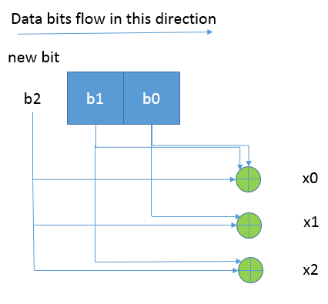
The Viterbi Algorithm
x0x1x2
Maintains and updates (make the strings one bit longer) the following every time 3 bits are received:
S0, c(S0)
S1, c(S1)
S2, c(S2)
S3, c(S3)
The new string will have two candidate strings, such as, new S0 can either be [old S0, 0] or [old S2, 0]. Pick the string with lower cost.
The cost is calculated as, for example, for [old S0, 0] , is c(S0) + the number of differenced between 000 and the received 3 bits.
S0
000
S0
111
110
S1
101
S1
001
010
S2
S2
011
S3
S3
100
Blue arrow: 0
Red arrow: 1

Slide 14
Exercise
Suppose the costs of S0, S1, S2, and S3 are 4, 5, 5, 6, respectively. Suppose the received bits at this step are 110 (oldest bit first). What will be the cost of the new S0?
Notes:
5, chosen from 10

Slide 15
The Viterbi Algorithm
Usually the strings for different states will converge from bit 0 up to some number of bits earlier than the current bit.
So the algorithm can output bit k when it has proceeded to bit k+L. L called the decoding depth.

Slide 16
Soft decoding
Taking a sample, we know how far it is from the actual symbol point.
Suppose the first 3 samples we received are [0.01, -1, 0.01]. Do you think the first data bit is 0 or 1?
I would say 0 because:
If it is 0, the ideal samples will be [-1,-1,-1], distance 2.02
If it is 1, the ideal samples will be [1,1,1], distance 3.98
Note: the actual probability may not be proportional to the distance value, will discuss later
However, if we quantize the samples, we get 101 and will choose 1 instead of 0.

Slide 17
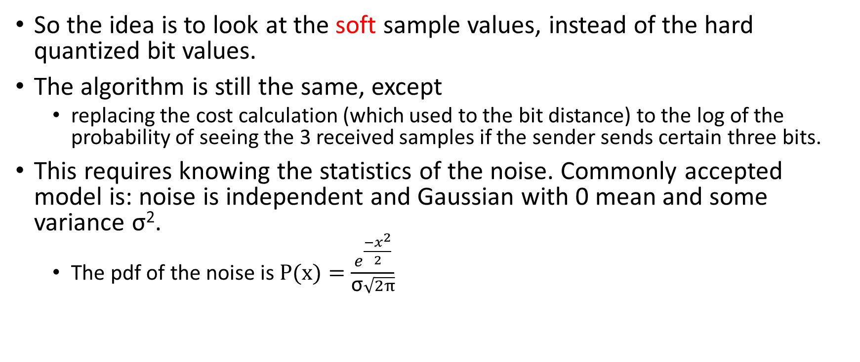
Soft decoding
So the idea is to look at the soft sample values, instead of the hard quantized bit values.
The algorithm is still the same, except
replacing the cost calculation (which used to the bit distance) to the log of the probability of seeing the 3 received samples if the sender sends certain three bits.
This requires knowing the statistics of the noise. Commonly accepted model is: noise is independent and Gaussian with 0 mean and some variance σ².
The pdf of the noise is $P(x)=\frac{e^{\frac{−x^{2}}{2}}}{\text{σ}\sqrt{2π}}$

Slide 18
Soft decoding
For example, if the first 3 samples we received are [0.01, -1, 0.01].
The soft cost for sending 000 is: constant – constant*(1.01² + 0² + 1.01²)
The soft cost for sending 111 is: constant – constant*(0.99² + 2² + 0.99²)

